Slide 1
Capstone Project Smart Menu Solution
Students: Lê Cao Minh Thành 6008
Hồ Anh Đức 60015
Trần Minh Trung 60025
Mạc Nguyên Khôi 60117
Nghiêm Tuấn Cường 60100
Supervisor: Dr. Phan Duy Hùng

Slide 2
Content
Introduction
Idea’s Origin
Existing SMSs
Conclusion
Scope
Global picture
Product
Feature
Hardware and Software
Hardware
Software
Yakindu
State chart Tool(SCT)
Editing
Simulation
Code generation
Demo
Testing
Conclusion

Slide 3



Introduction
Idea’s Origin
Waste time

Slide 4





Introduction
Idea’s Origin
Costly
Redundancy

Slide 5
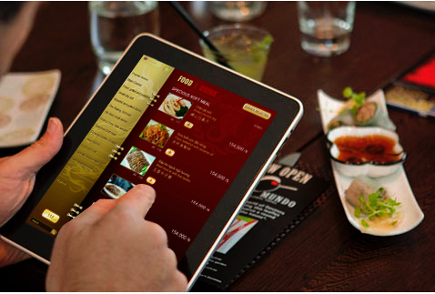
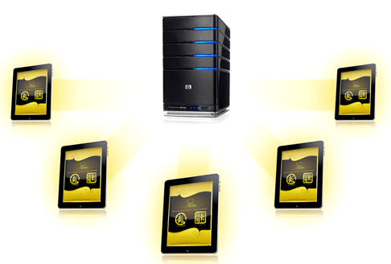
Introduction
Existing Systems
A system is installed on server
Application runs on Ipad/Tablet (Client) thought server
iMENU
Bach Hop Company (BICWeb.VN)
Choosing dishes thought IPAD, tablet
http://www.bicweb.vn

Slide 6
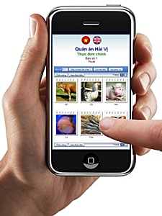
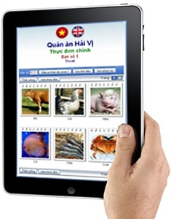
Introduction
Existing Systems
ezMenu
http://vienphuc.com/ezmproduct.htm

Slide 7
Introduction
Conclusion
Actual needs:
Lost time for waiting to note orders.
Have errors and lead to debate later when notes by papers.
High expense and hard to control a lots waiter.
None of the existing system is widely applied in Viet Nam because:
Price,
Functionality,
Usability, etc.
→ The market is still available for our product.

Slide 8
Introduction
Scope
Provide the basic functions:
Ordering: Provide a new electric device replace a traditional ways in ordering dishes.
Management: Provide a window management software to manage orders, billing, statistic and automatically distribute dishes to chef.
Research & apply formal methods development (Yakindu) into executable embedded system.
Provide a long-term stable system.
Have acceptable price.

Slide 9


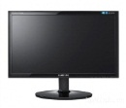
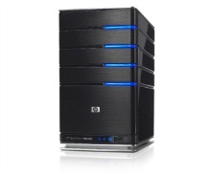

Introduction
Global picture
Cashier
SMO Device
SMR Device
SMO Device
Kitchen
…
PC Server
SMO: Smart Menu Ordering
SMR: Smart Menu Receiver
Printer

Slide 10

Introduction
Product
SMO
SMR
LCD Display
Microprocessor
RF module
Radio Signal
RF module
Microprocessor
USB module
Keypad
Radio signal
BUS
RF module
SMC
Microprocessor
Keypad

Slide 11
Introduction
Priciples

Slide 12
Introduction
Features
Using SMO to select menu.
Support two languages: English or Vietnam
View dishes' status: not done, doing or done.
May cancel dishes if it haven’t been done yet.
Call waiter for additional or unusual request.
Automatic distribute orders to kitchen.
Quick billing.
Develop using “Yakindu” for easy maintain and update.

Slide 13
Introduction
Risk
Half of project team members do not have experiences working in real project.
The team leader lack of project management skill, experiences.
None of the project team members has been work as tester position.
The facilitation for developing the project maybe the risk (like places, equipment , etc…)
Lack of experiences of estimating time and budget for developing project.

Slide 14
Hard&Soft
Hardware List
Slide này list toàn bộ hardware device trong project + hình ảnh nếu được

Slide 15
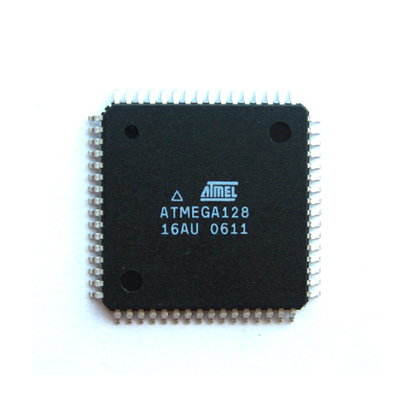
Hard&Soft
Hardware
High-performance, Low-power AVR® 8-bit Microcontroller
High Endurance Non-volatile Memory segments
JTAG (IEEE std. 1149.1 Compliant) Interface
Peripheral Features
Special Microcontroller Features
I/O and Packages
Operating Voltages: 4.5 - 5.5V
Speed Grades: 0 - 16 MHz
Atmega128A

Slide 16
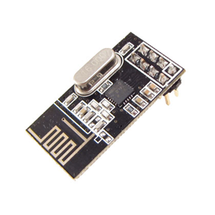
Hard&Soft
Hardware
Low cost single-chip 2.4GHz GFSK RF transceiver IC
Worldwide license-free 2.4GHz ISM band operation
1Mbps and 2Mbps on-air data-rate
Enhanced ShockBurst™ hardware protocol accelerator
Ultra low power consumption – months to years of battery lifetime
nRF24L01

Slide 17
Hardware
Design
Circuit Design

Slide 18
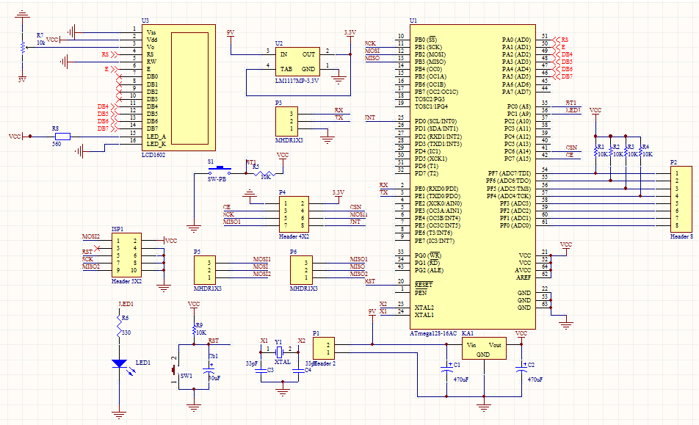

Slide 19
Hardware
Design
Firmware Programming

Slide 20
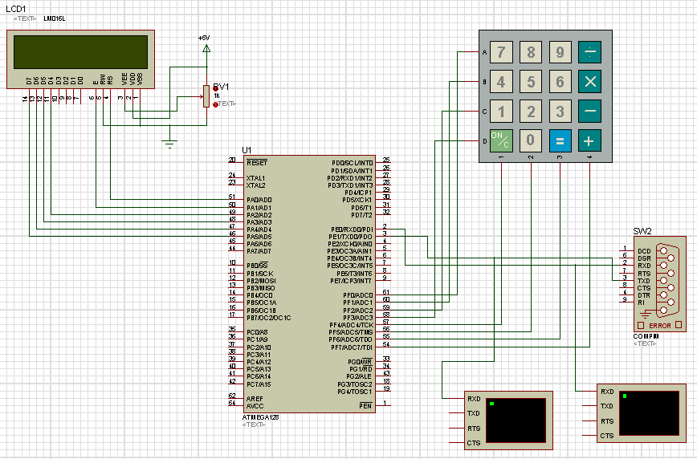

Slide 21
Hardware
Design
Slide này bỏ hình mạch thực tế

Slide 22
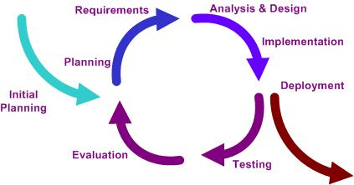
Hard&Soft
Software
Iterative development model
Notes:
Planning phase, in which the plane for this project is created
Requirement phase, in which the requirements for the software are gathered and analyzed.
Design phase, in which software solution to meet the requirements is designed.
Implementation phase, when the software is code and integrated.
Test phase, when the software is tested.
Evaluation phase, in which the software is evaluated.
Deployment phase, in which the system is deployed.

Slide 23
Software
Design
Slide này bỏ hình Software Interface chạy trên PC

Slide 24
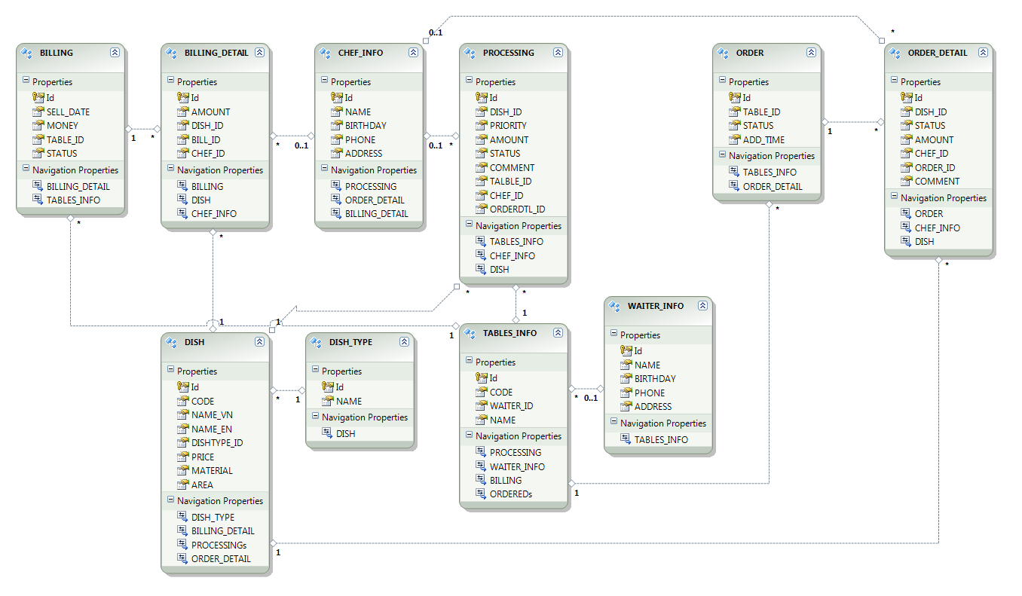
Hard&Soft
Entity Framework

Slide 25
Yakindu
YAKINDU
is a modular toolkit
for model-based development
(of embedded systems)

Slide 26
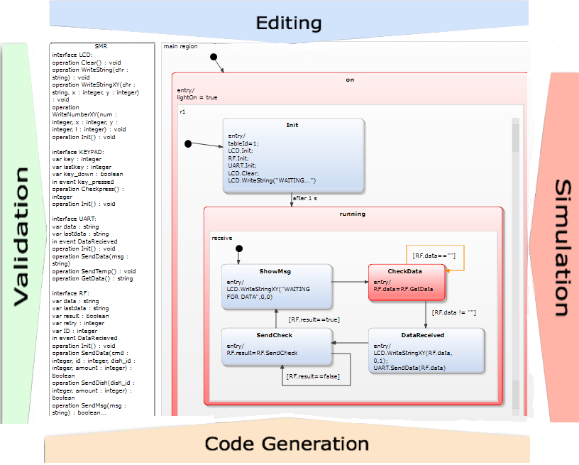
Yakindu
Statechart Tools (SCT)

Slide 27
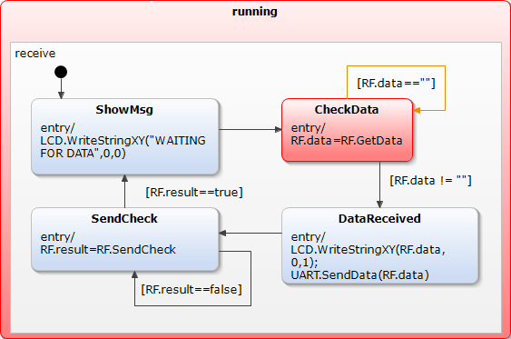
Yakindu
Statechart Tools (SCT)
Formalism similar to state machines as defined by David Harel, but:
self-contained with a well defined interface
with a cycle-based execution semantics
allows processing concurrent events
event-driven behavior can be defined on top
time control is delegated to the environment

Slide 28
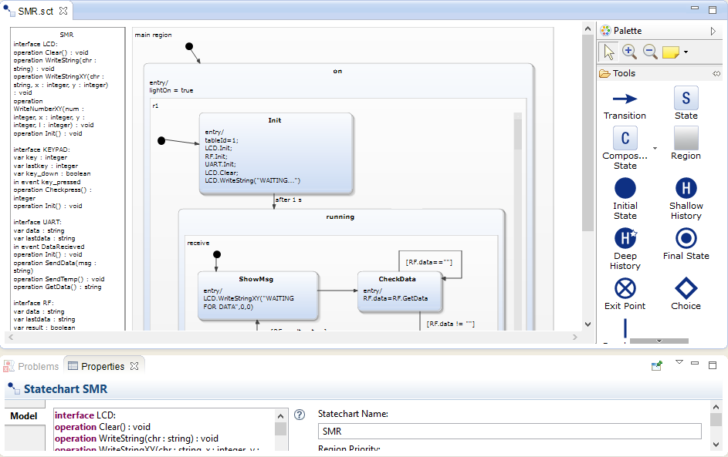
Yakindu
Editing

Slide 29
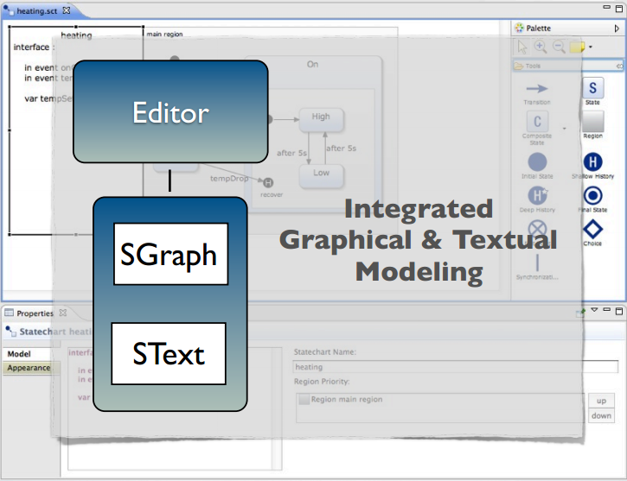
Yakindu
Editing

Slide 30
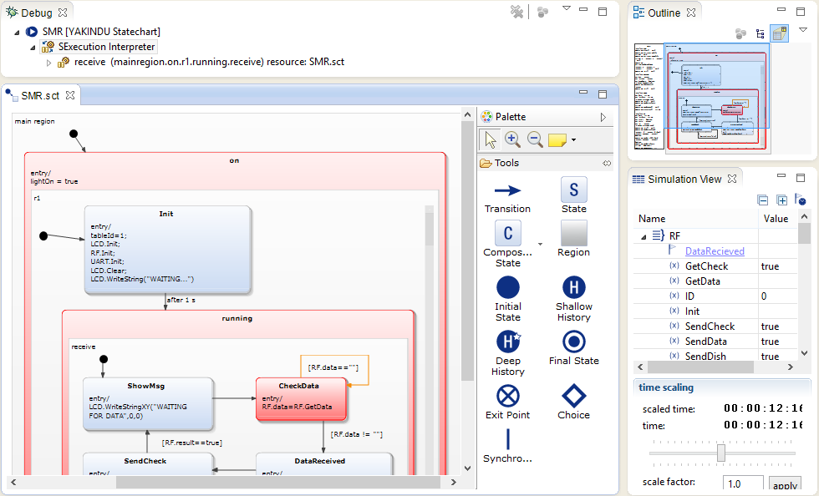
Yakindu
Simulation

Slide 31
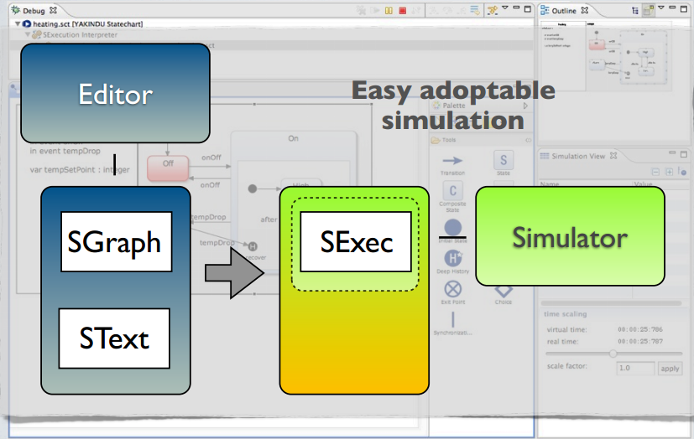
Yakindu
Simulation

Slide 32
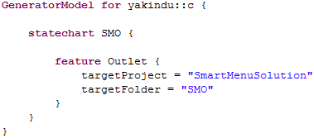
Yakindu
Code generation
Yakindu comprises code generators for Java, C, C++
All generators can be „customized“ by a generator model
Custom generators based on Xpand & Xtend2/Java can be easily integrated

Slide 33
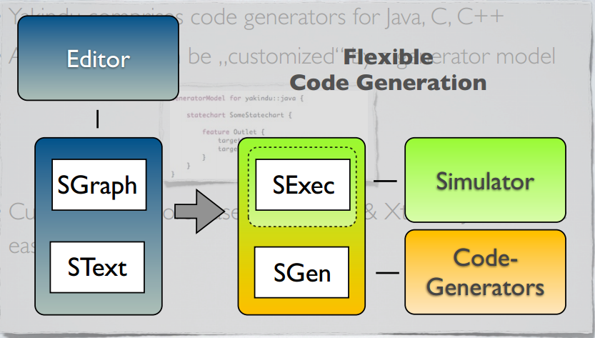
Yakindu
Code generation

Slide 34
Yakindu
Demo
DEMO

Slide 35
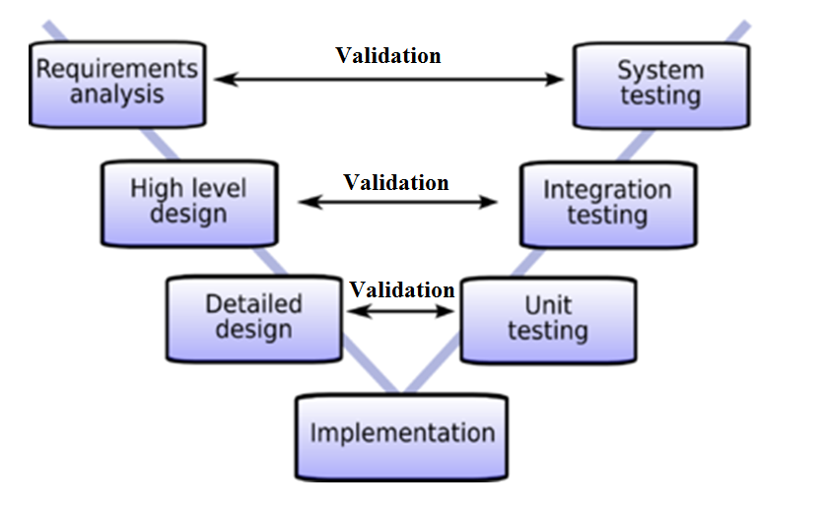
Testing
Result
Test Strategy

Slide 36
Testing
Embedded System Testing
RS232 testing
Atmega128A testing
nRFL2401 testing
LCD display testing
Keyboard testing
Data transferring testing
Information System Testing
GUI testing
Functions testing
Insert database testing
Connect COM port testing

Slide 37
Testing
Result
Slide này ghi
số test case
Số bug
Trong 3 quá trình test: Unit test, integration test, system test.

Slide 38
Limitations
Result
Control software
Control software design is monotonous
Software didn’t have many functions
Do not display all system operations
Database design is not in standard
Sometimes not operate reliability
Source code is quite complicated
Counter printed board
Operate in 9V power only
Still cannot transfer data in a long distance (desire possible)
Design is not complete
Connection sometimes not reliability

Slide 39
Conclusion
Future Improvement
Large restaurant
Expensive price
Provide software in tablet
Have all basic function
Can custom comment dishes
No need paper menu

Slide 40
THANK YOU!

